Slide 1
CLUSTERING OF HUMAN FACES
GROUP NO: A13
Srujan teja 1602-20-737-046
Sruthibhavana 1602-20-737-047
Umadevi 1602-20-737-056

Slide 2
MOTIVATION
It is difficult to identify the faces from cctv footage and blur images so in order to make this task easier, we are clustering faces which makes identification of faces easy.

Slide 3
ABSTRACT
Clustering of human faces with captured expressions, movements, voice and other features in real time videos is still a challenging task.
Design a prototype system with advance techniques of image recognition.
The prototype system must render the image of identified person in the video such that the face orientation changes dynamically with the body movement.
Effects like face expressions, movements must be captured effectively to give feeling of real human face.

Slide 4
INTRODUCTION
The main moto of our project is to identify the human face by observing the different movements and expressions in the video and recreate the human face.
We will be using the AI/ML techniques to identify or capture the expressions and movements of a particular person from the videos .
The techniques used for facial recognition are feature based, appearance based and template matching.
Face clustering is a technique used to group together similar faces in a collection of images. It is often used for tasks such as organizing photos, identifying individuals in surveillance footage, or detecting duplicates in a dataset.

Slide 5
INTRODUCTION
The face is recognized by tracing the nodal points on face and calculating the distance between the nodal points and it may collect up to 80 different measurements.
We recreate the face by capturing from 4-5 different images from different angles.
It is very helpful to identify the criminals from CCTV footage by our project which would help to reduce the crime rate.

Slide 6
REQUIREMENTS
Languages: python
Frontend: html, css
Libraries: OpenCV, numpy , dlib , face_recognition
IDE : VS Code.
Data Set: Google Facial Expression Comparison Dataset

Slide 7
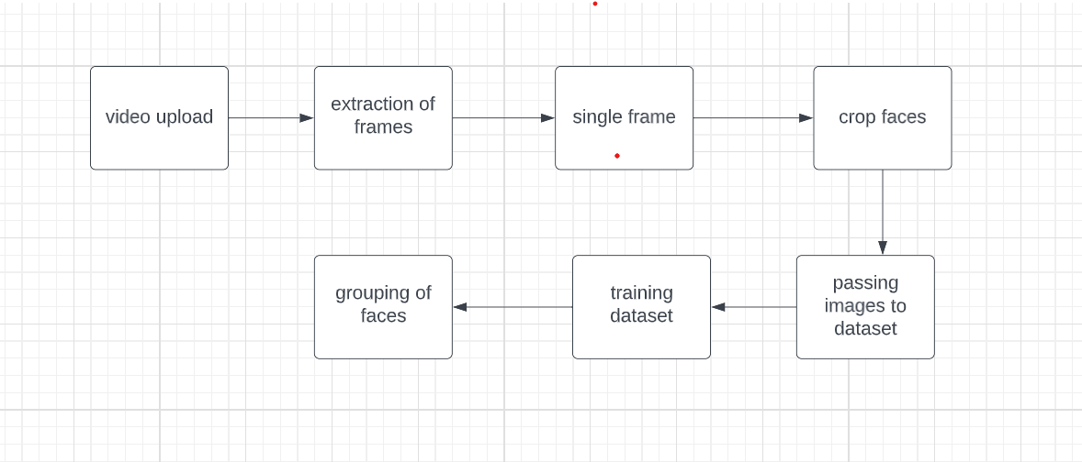
WORKFLOW

Slide 8
DESIGN OF SOLUTION
User have to upload image /video.
The user can select their choice among the options displayed on the webpage
1. Recognizing face from video
2. Number of faces in the video/image -extract
3. Grouping of similar face images recognized from video( Clustering concept can be used)
4.Recreating the final facial image

Slide 9
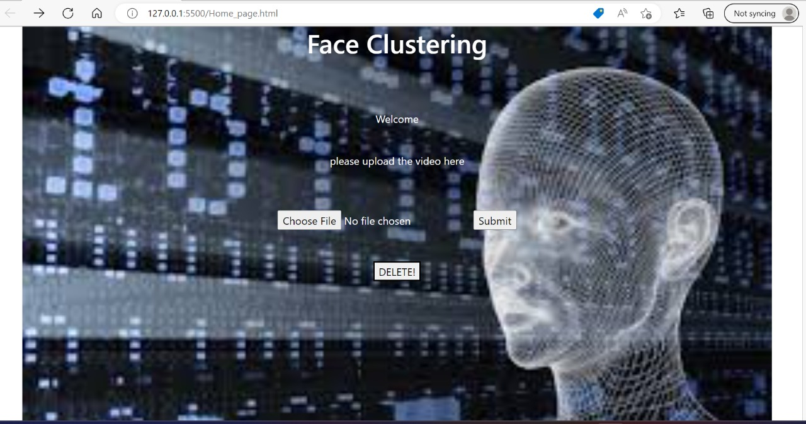
OUTPUT

Slide 10
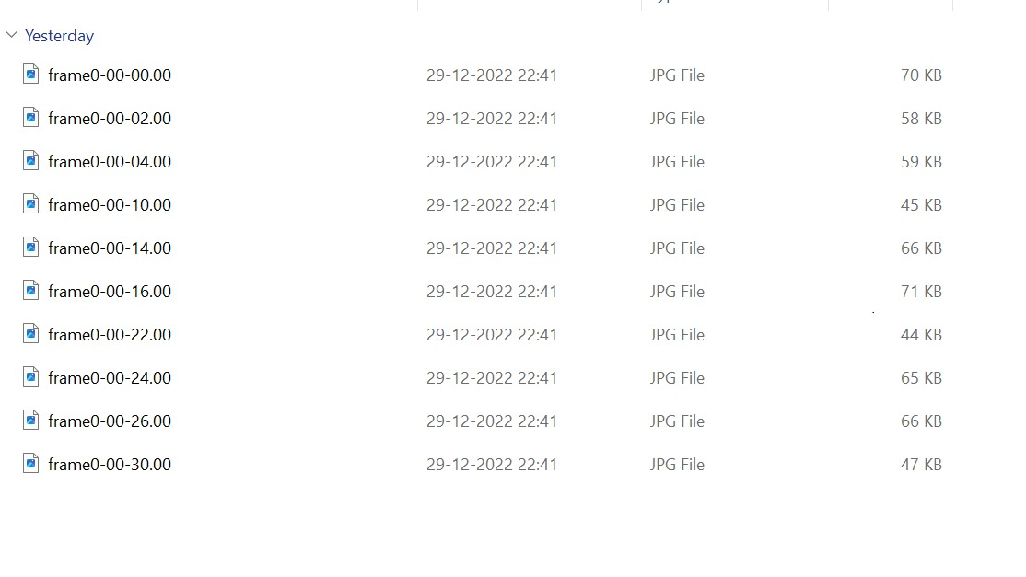
OUTPUTS
EXTRACTING OF FRAMES

Slide 11
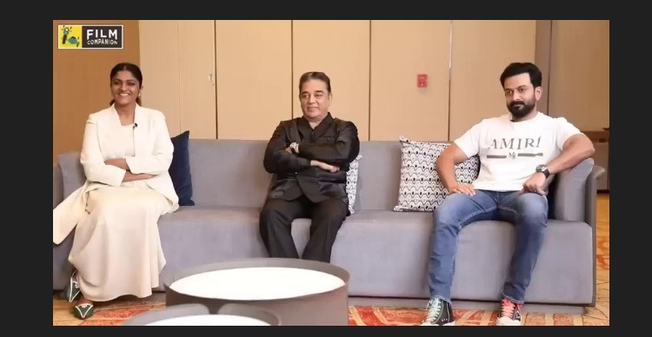
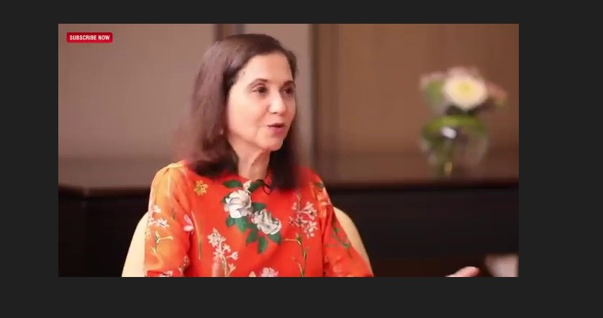
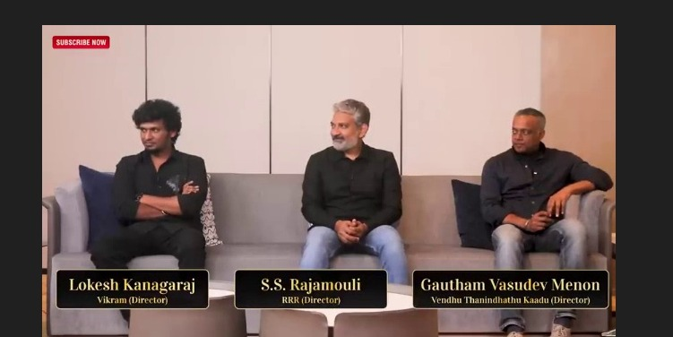

Slide 12
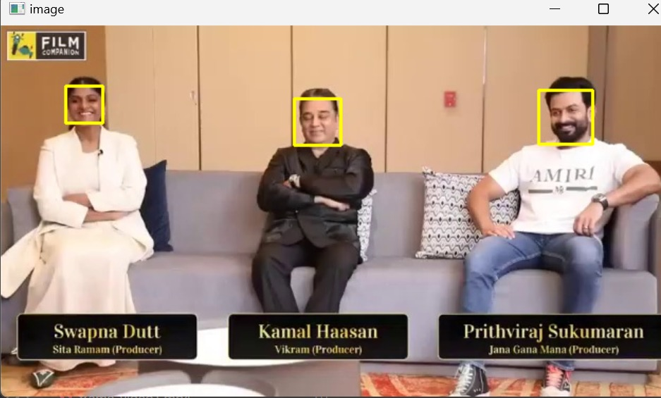
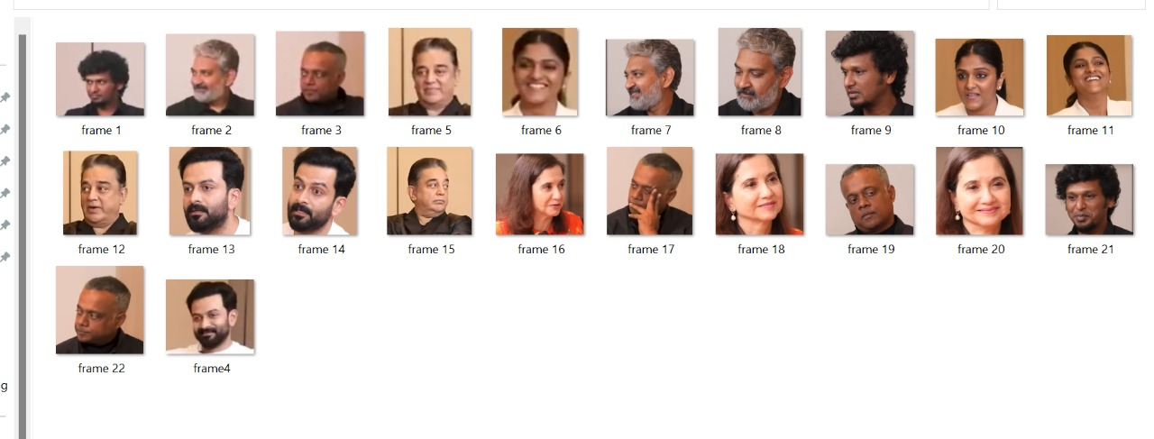
CROPPING FACES

Slide 13
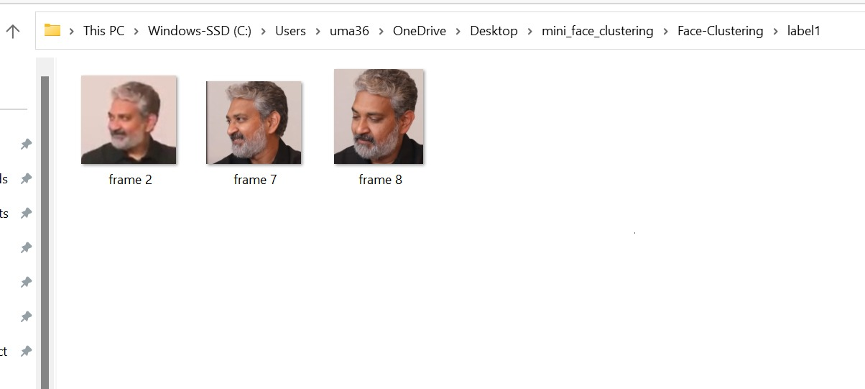
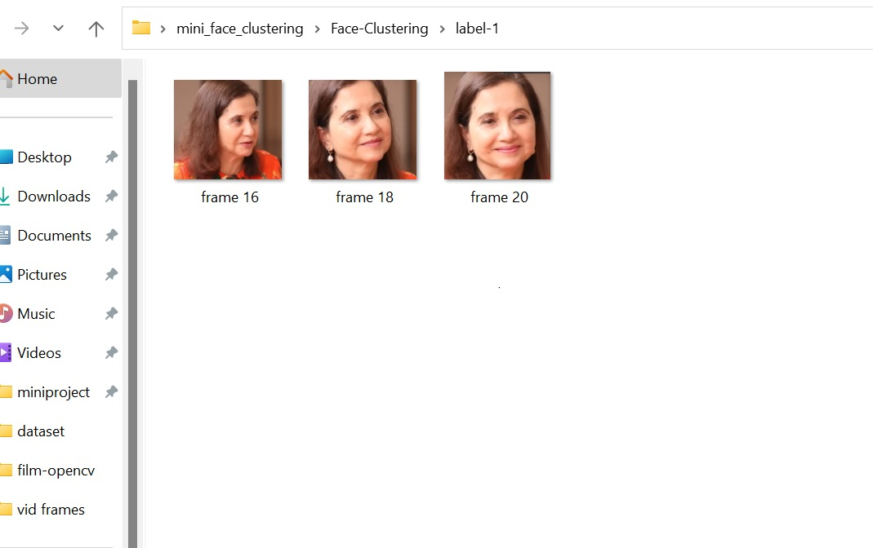
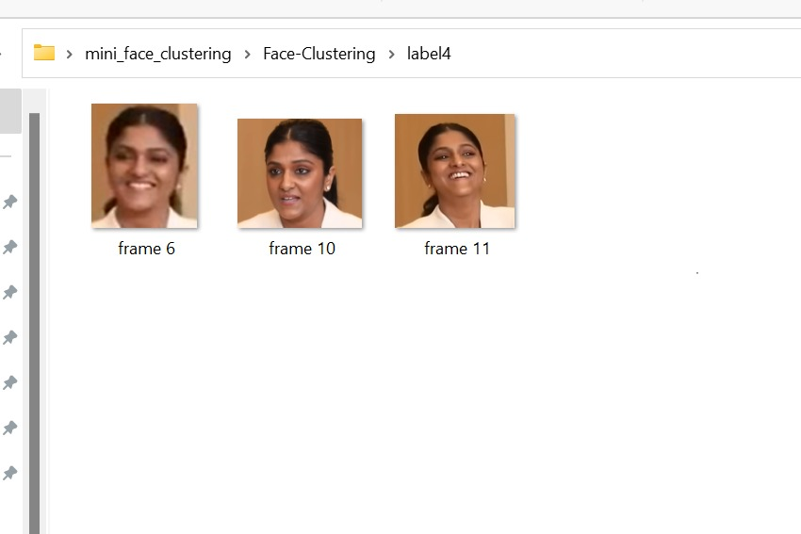
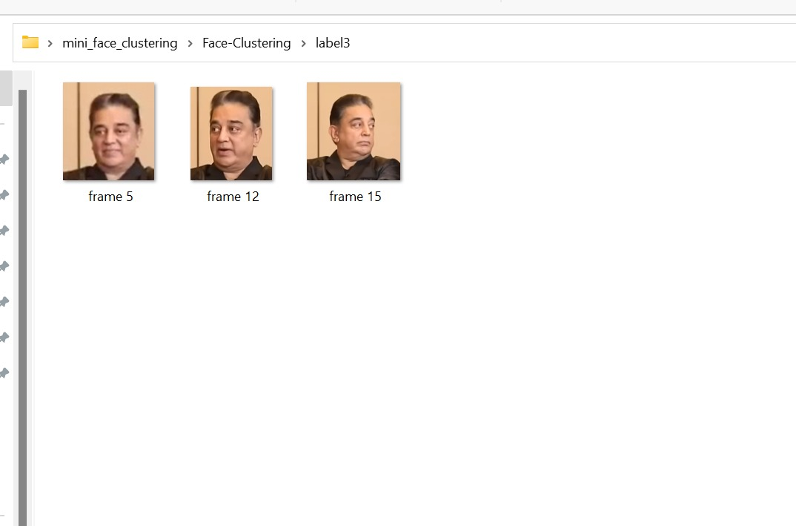
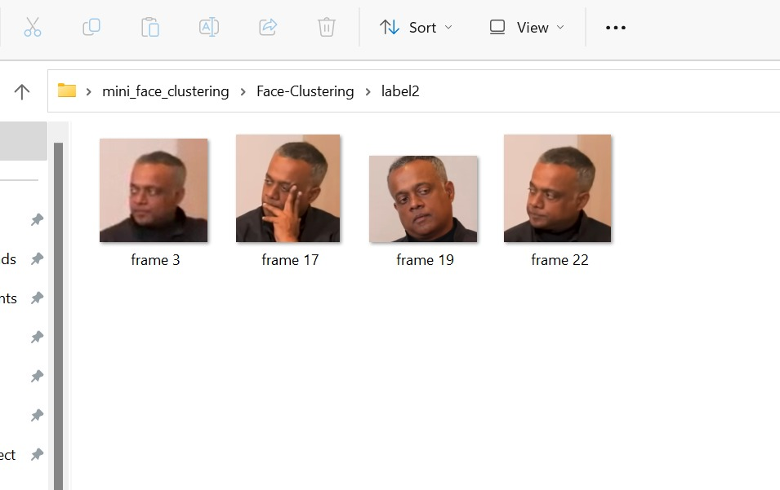
CLUSTERING FACES

Slide 14
CONCLUSION &FUTURE SCOPE
Identification of faces will be easier by recreating faces.this could be used to find people whose faces are not clear or faces that are potrayed in different angles( so that it could be easier to find thieves easier) .
It could be helpful to identify and compare faces from a huge crowd .
They can be segmented into blacklist and whitelist applications. Blacklist applications include the ones related to security & surveillance and identification of criminals.

Slide 15
REFERENCES
https://www.google.com/url?sa=i&url=https%3A%2F%2Fgithub.com%2Fdmitrykhramov%2FSmart-Bell&psig=AOvVaw3n6ZtCb1VWBTJrwHOhvns7&ust=1670996933604000&source=images&cd=vfe&ved=0CBAQjRxqFwoTCJjyuufy9fsCFQAAAAAdAAAAABAE
https://github.com/guesswh0/face_comparison

Slide 16
THANK YOU
- Neil Armstrong

